Slide 1
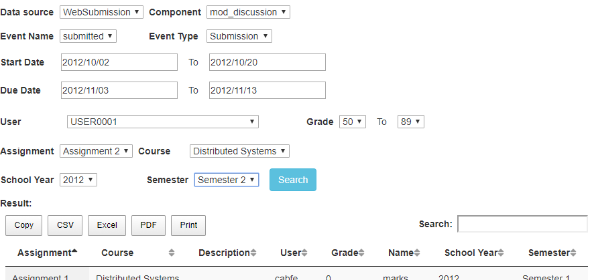
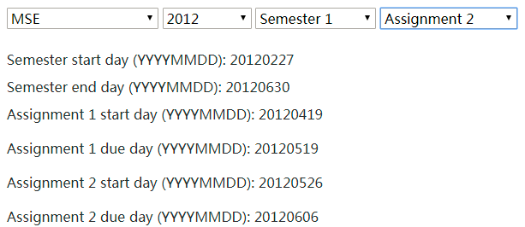
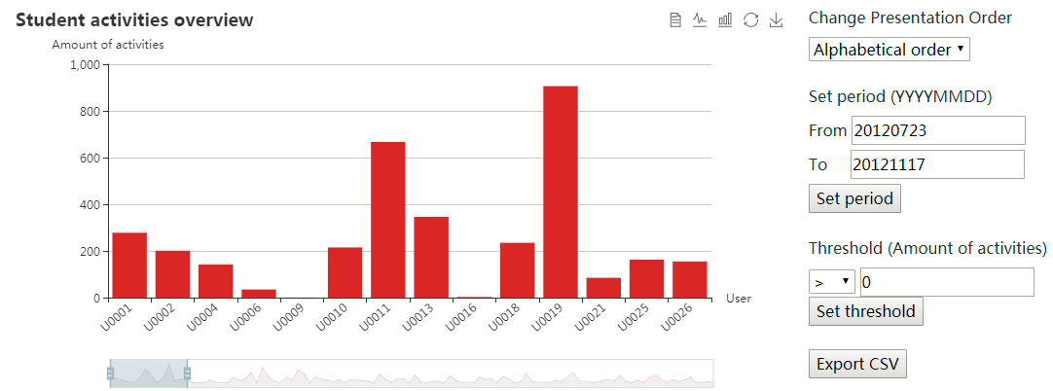
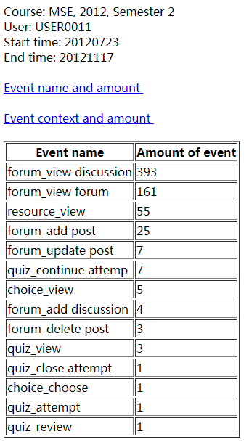
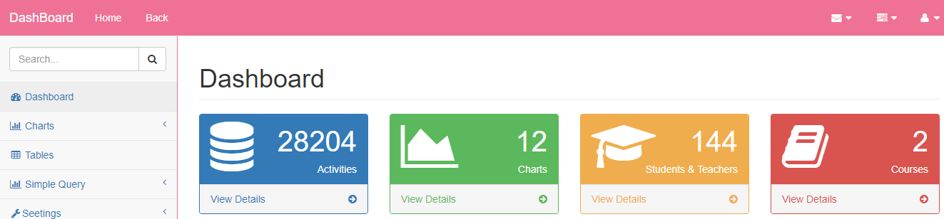
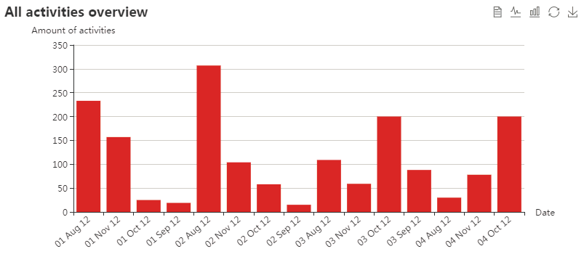
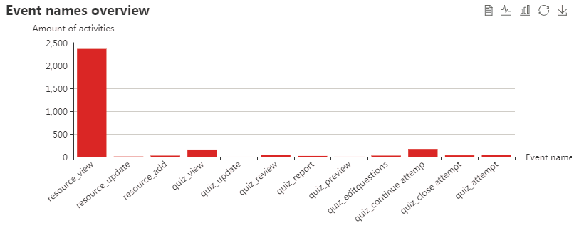
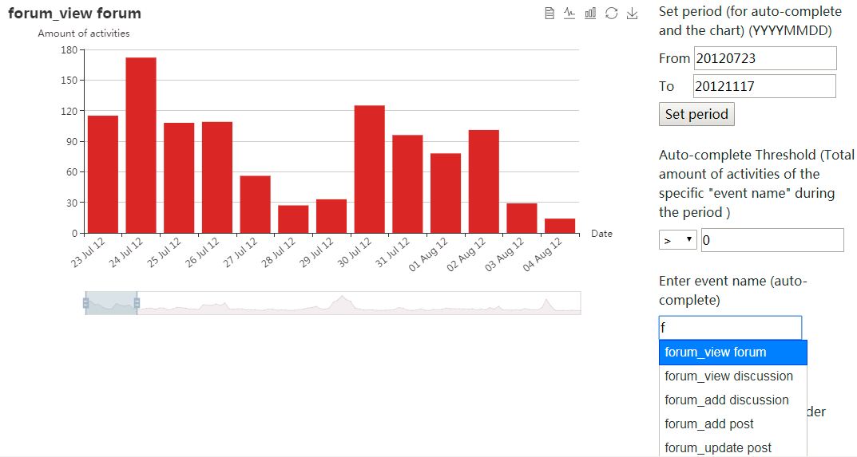
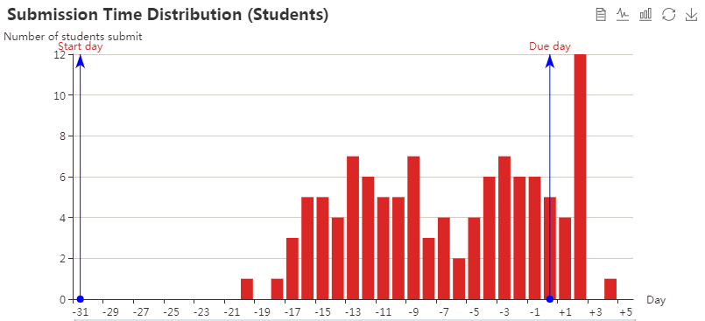
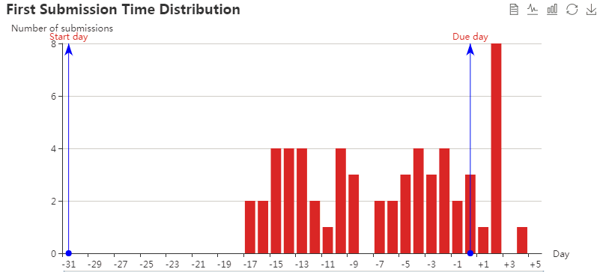
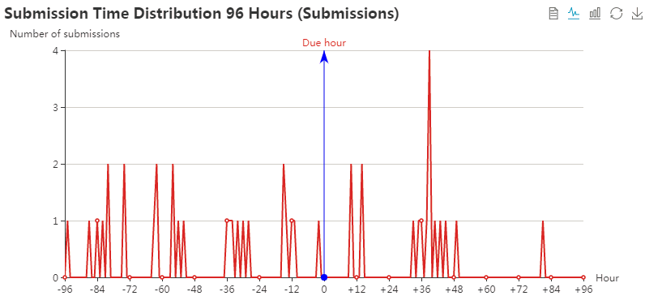
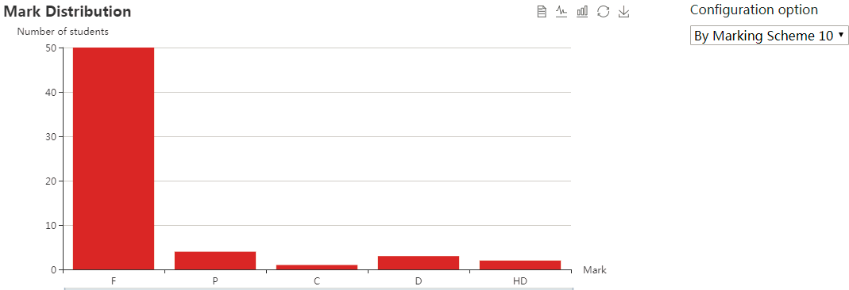
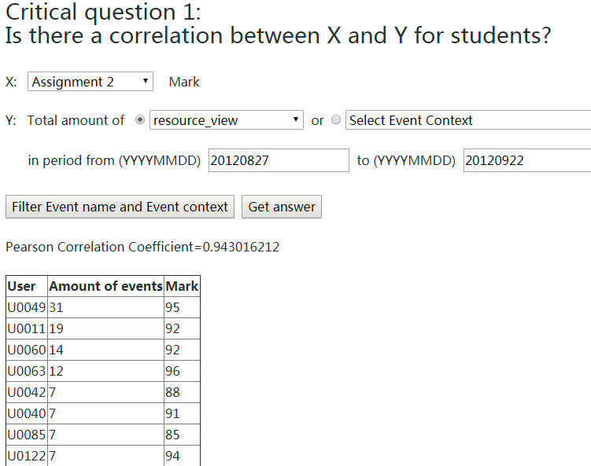
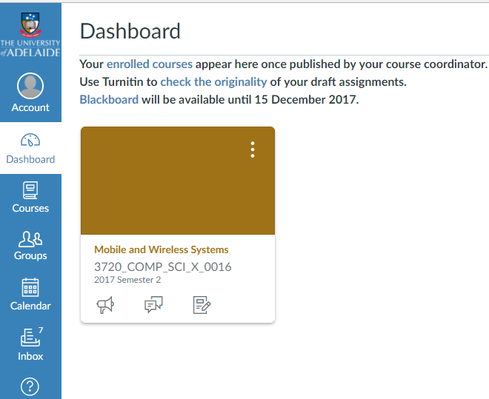
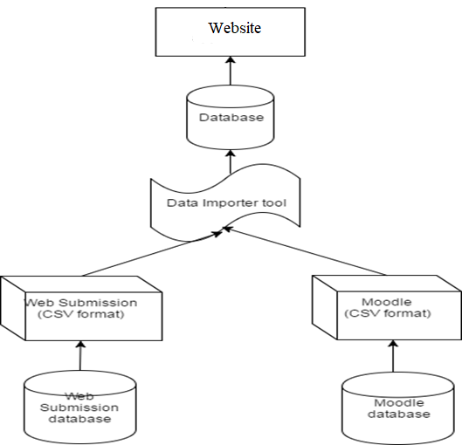
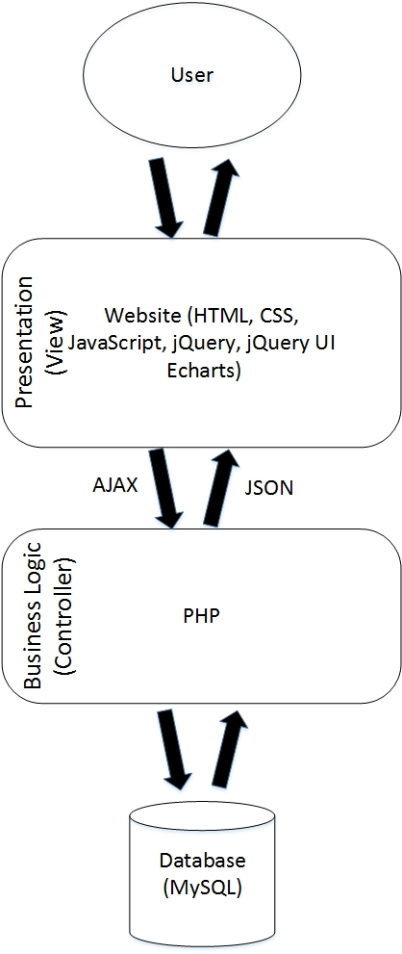
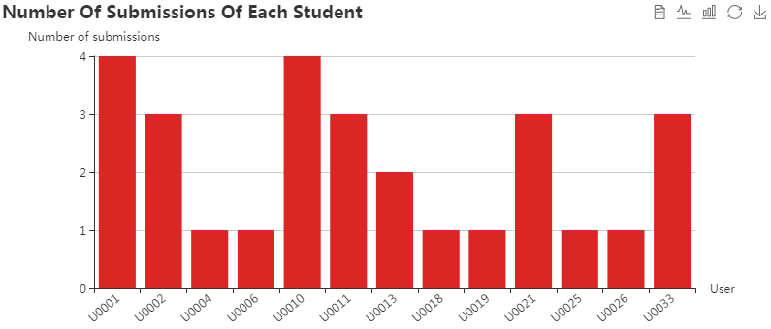
Organised Access to Historical Student Data
Zeyu Lin, Minh Tam Phan, Zeqi Fu (zeyu.lin, minhtam.phan, zeqi.fu) @student.adelaide.edu.au
Supervised by Nickolas Falkner, Claudia Szabo, Christoph Treude, Marian Mihailescu
School of Computer Science
Project Introduction
Charts and analysis module
Data query module
The school of computer science has collected a large amount of student data over the years in a number of different sources. This project has assisted to present those collected data in neatly visualized forms for better and easier decision making.
Activities of individual student
The database schema is built based on two data sources (Moodle Forum and WebSubmission).
Data Importer tool extracts data from data sources to database.
The website displays and analyzes data by charts and tables.
The website is designed in a decoupled way. It adopts two-tier model, which separates the front-end and the back-end.
Choose course, year, semester, assignment
Alphabetical, descending, ascending order
Clicking the bar will give details of activities
Searching criteria
Filter data by threshold
Copy result data to clipboard
Automatically set
Export data in CSV format
Export result data to CSV
Activities of the class
Export result data to Excel
Export result data to PDF
Amount of all activities
Breakdown of activities
Specific activity
Print result data
Project Objective
The activity can be set
Search data
To provide a flexible database schema linking two data sources (Moodle forum and WebSubmission system).
To import data from file-based sources into the database.
To visualize data by charts and make them configurable to allow users to manipulate and interact with data. Configuration options include: change presentation order, set start day and end day, set threshold, set activity, set course, year, semester and assignment.
To analyze the relationship between the amount of students’ activities and academic performances.
To assist the staff to query, aggregate and export data with functionalities such as copying data to clipboard; printing and exporting data to Excel, CSV, PDF.
Result data
Provide visualization by using charts, which make the data intuitive and easy to read.
Provide lots of configuration options and related functions (set period, change presentation order, threshold function, export data in CSV format, event name/ event context auto-complete), which allow user to further explore and manipulate data.
Allow user to choose course, year, semester, assignment.
Provide data of individual student as well as the whole class.
Provide the amount of different events in a given period as well as the amount of specific event of each day.
Link two data sources and link the users of two data sources.
Provide cross data analysis: allow user to explore the relationship between the amount of students' activities and academic performances.
Advantages
Auto-complete, choose the activity for this chart
Submission pattern
Analyze complicated data in visualized forms.
Provide data of individual student as well as the class.
Query, aggregate, extract and export data in several formats such as excel, pdf, csv or printing.
Combine data of several data sources.
Link data of many data sources.
Submission pattern of the class
When do students make first submissions?
Are there spikes in the last 96 hours?
Annotate assignment start, due day
Future work
Relationship between activities and academic performances
System Architecture
Configurable, by Marking Scheme 10/ by 10% step
Modify the schema to work with new data sources (Canvas).
Add new data sources (e.g. student GPA) for further cross data analysis.
Provide charts (across semesters) of the same course for trend analysis and comparison.
Automatically calculated
The database is flexible and can be applied for multiple data sources.
Having tools to import data from external files.
Visualization makes the data intuitive.
Charts are configurable, which allows user to manipulate and further explore data.
Link users of two systems
(Restful API, Slim Framework)
Acknowledgement
This project was supported by the School of Computer Science. We gratefully acknowledge the feedback and contribution of Nickolas Falkner, Claudio Szabo, Christoph Treude and Marian Mihailescu.

